Slide 1
Types of Regression Algorithms
Atharva Dixit 38
Aditya Holkar 57
Upendra Kadre 69
Swapnil Katti 72

Slide 2
Content
What is Regression?
Linear Regression
Multiple Linear Regression
Polynomial Regression
Logistic Regression
Stepwise Regression

Slide 3
What is Regression?
A regression problem is when the output variable is a real or continuous value, such as “salary” or “weight” or "age"
It targets the prediction value based on independent variables
Different Regression model are differ upon number of independent variables used and the kind of relationship between dependent & independent variables

Slide 4
Linear Regression
Based on Supervised Learning
It predicts a dependent variable value (y) based on a given independent variable (x). Thus, it finds a linear relationship between x (input) and y(output).

Slide 5
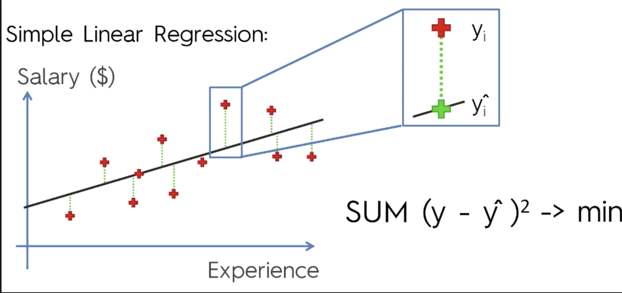
Hypothesis function
y=θ₁ + θ₂•x
x: input training data (independent variable) y: dependent variable
θ₁: intercept
θ₂: coefficient of x
Once we find the best θ₁ and θ₂ values, we get the best fit line

Slide 6

Cost Function(J)
Predict y value such that the error difference between predicted value and true value is minimum.
Reach the best value that minimize the error between predicted y value (pred) and true y value (y) by updating the θ₁ and θ₂ values.

Slide 7
Multiple Linear Regression
It attempts to model the relationship between two or more features and a response by fitting a linear equation to observed data
Almost similar to linear regresssion
Find out which factor has the highest impact on the predicted output

Slide 8
Hypothesis function
Y= b0 + b1 * x1 + b2 * x2 + b3 * x3 + …… bn * xn
Y = Dependent variable
x1, x2, x3, …… xn = multiple independent variables

Slide 9
Assumptions of Regression Model :
Linearity: The relationship between dependent and independent variables should be linear
Homoscedasticity: Constant variance of the errors should be maintained
Multivariate normality: Multiple Regression assumes that the residuals are normally distributed
Lack of Multicollinearity: It is assumed that there is little or no multicollinearity in the data

Slide 10
Polynomial Regression
It is used for curvillinear data
The relationship between the independent variable x and dependent variable y is modeled as an nth degree polynomial
It is a nonlinear relationship between the value of x and the corresponding conditional mean of y
They are used to describe non-linear phenomenon like progression of disease epidemics, distribution of carbon isotopes in lake sediments

Slide 11
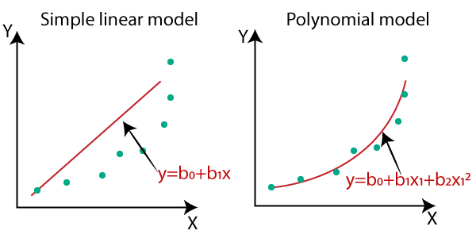
Hypothesis function
The hypothesis function of polynomial regression is generally stated as
y=a + b1x + b2x^2 +..+ bnx^n +e
y is dependent variable
a is y intercept
b is the slope
e is the error rate

Slide 12
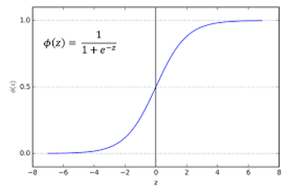
Logistic Regression
A supervised classification algorithm
Predict the probability that a given data entry belongs to the category numbered as “1”
Logistic regression models the data using the sigmoid function

Slide 13
Types of Logistic Regression
Based on the number of categories, Logistic regression can be classified as:
Binomial: only 2 possible types “0” or “1”
Multinomial: 3 or more possible types without ordering
Ordinal: Target variables with ordered categories

Slide 14
Stepwise Regression
It is used for fitting regression models with predictive models
With each step, the variable is added or subtracted from the set of explanatory variables
It is achieved by observing statistical values like R-square, t-stats and AIC metric to discern significant variables

Slide 15
Stepwise Regression
It fits the regression model by adding/dropping co-variates one at a time based on a specified criterion
The most common methods are:
Standard stepwise regression - It adds and removes predictors as needed for each step.
Forward selection - starts with most significant predictor in the model and adds variable for each step
Backward elimination - starts with all predictors in the model and removes the least significant variable for each step

Slide 16
Thankyou

